Slide 1
Chapter 1 Introduction
1.1 Concept and Application
1.2 Objectives and Evolution
1.3 Needs of DBMS
1.4 Data Abstraction
1.5 Data Independence
1.6 Schema and Instances
1.7 Concept of DDL, DML and DCL
1.8 Database Manager and Users
Database Application Architecture
Database System Architecture

Slide 2
1.1 Concept and Application
Data : Collection of facts, such as numbers, words, measurements, observations or just descriptions of things.
Data are raw facts.
They are meaningless until they are sorted.
After data processing, we get meaningful facts is called Information.
Talking in terms of computing, data is basically information that can be translated into a particular form for efficient movement and processing.
Example: Name, age, weight, height, etc.

Slide 3
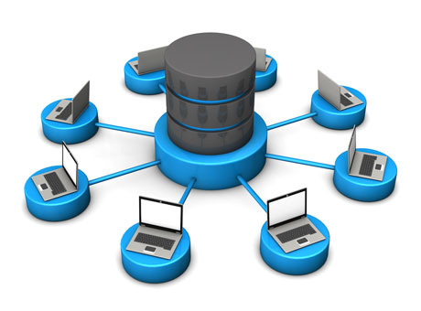
What is Database?

Slide 4
1.1 Concept and Application
Database is an organized collection of structured data to make it easily accessible, manageable and update.
In simple words, you can say, a database in a place where the data is stored.
Database is collection of related data.
Example: Library
The library contains a huge collection of books of different genres, here the library is database and books are the data.

Slide 5
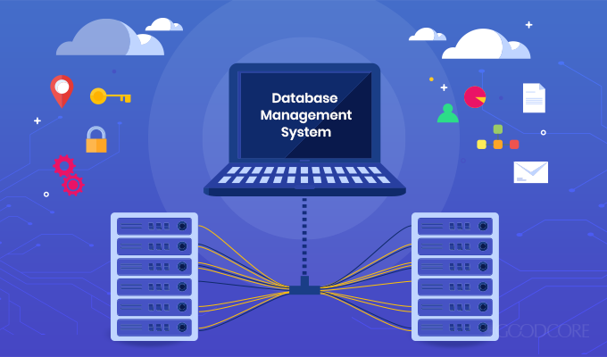
What is Database Management System?

Slide 6
1.1 Concept and Application
Database Management System is a software application used to access, create, and manage databases.
A DBMS consists of a group of commands to manipulate the database and acts as an interface between the end-users and the database.
Provides a way to store and retrieve data in both convenient and efficient manner.
Examples: Oracle, SQL Server, MySQL etc.

Slide 7
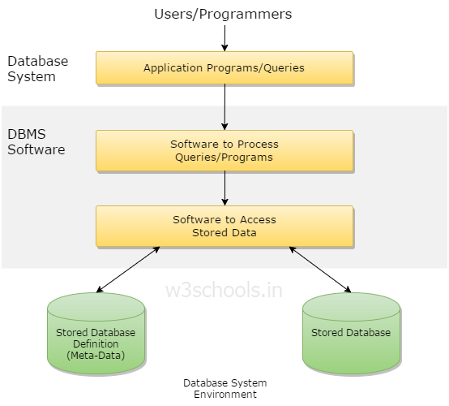
Simplified Database System Environment

Slide 8
1.1 Concept and Application
Database Management Systems allows users to do the following:
Define Data – Allows the users to create, modify and delete the definitions which define the organization of the database.
Update Data – Provides access to the users to insert, modify and delete data from the database.
Retrieve Data – Allows the users to retrieve data from the database based on the requirement.
Administration of users – Registers the users and monitors their action, enforces data security, maintains data integrity, monitors performance and deals with concurrency control.

Slide 9
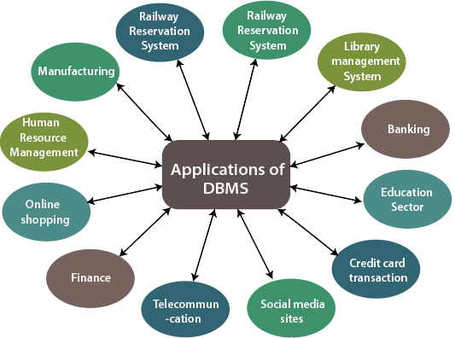
1.1 Concept and Application

Slide 10
1.2 Objectives and Evolution
Objectives of DBMS:
Provide for mass storage of relevant data,
Make access to the data easy for the user,
Provide prompt response to user requests for data,
Make the latest modifications to the database available immediately,
Eliminate redundant data,
Allow for multiple users to be active at one time,
Allow for growth in the database system,
Protect the data from physical harm and unauthorized access.

Slide 11
1.2 Objectives and Evolution
Evolution of DBMS:
Year 1968: File based system
Year 1968 – 1980 : Hierarchical Database
Year 1960s : Network Data Model
Year 1970 – Present : Relational Database Management System, Object – based Database
For more, Go to the link below:
https://www.youtube.com/watch?v=8eYmdW9PBZc

Slide 12
1.3 Needs of DBMS
Processing Queries and Object Management
Controlling redundancy and inconsistency
Efficient memory management and indexing
Concurrency control and transaction management
Access Control and ease in accessing data
Integrity constraints
Data security
Data scalability, expandability and flexibility
https://www.geeksforgeeks.org/need-for-dbms/

Slide 13
1.4 Data Abstraction
Database systems comprise of complex data-structures.
In order to make the system efficient in terms of retrieval of data, and reduce complexity in terms of usability of users,
developers use abstraction i.e. hide irrelevant details from the users.
This approach simplifies database design.

Slide 14
1.4 Data Abstraction
There are mainly 3 levels of data abstraction:
Physical level: This is the lowest level of data abstraction. It describes how data is actually stored in database. You can get the complex data structure details at this level.
Logical level: This is the middle level of 3-level data abstraction architecture. It describes what data is stored in database.
View level: Highest level of data abstraction. This level describes the user interaction with database system.

Slide 15
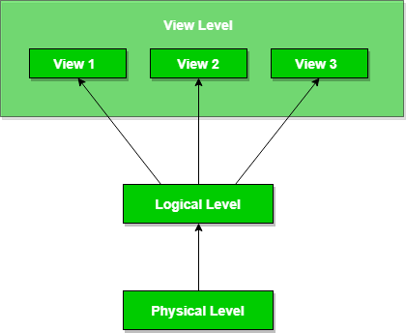
1.4 Data Abstraction

Slide 16
1.4 Data Abstraction
Example: Let’s say we are storing customer information in a customer table.
At physical level these records can be described as blocks of storage (bytes, gigabytes, terabytes etc.) in memory. These details are often hidden from the programmers.
At the logical level these records can be described as fields and attributes along with their data types, their relationship among each other can be logically implemented. The programmers generally work at this level because they are aware of such things about database systems.
At view level, user just interact with system with the help of GUI and enter the details at the screen, they are not aware of how the data is stored and what data is stored; such details are hidden from them.

Slide 17
1.5 Data Independence
The main purpose of data abstraction is achieving data independence in order to save time and cost required when the database is modified or altered.
Data Independency can be defined as the capacity to change the schema at one level of a database system without having to change schema at the next higher level.

Slide 18
1.5 Data Independence
Both data abstraction and data independence hide implementation details from users.
This allow user to focus on the general structure rather than low-level implementation.
There are mainly two types of Data Independence:
Physical Data Independence
Logical Data Independence

Slide 19
1.5 Data Independence
1.Logical data independence:
Ability to change the logical (conceptual) schema without changing the External schema (User View)
For example, the addition or removal of new entities, attributes, or relationships to the conceptual schema should be possible without having to change existing external schemas or having to rewrite existing application programs.
2.Physical data independence:
Ability to change the physical schema without changing the logical schema
For example, a change to the internal schema, such as using different file organization or storage structures, storage devices, or indexing strategy, should be possible without having to change the conceptual or external schemas.

Slide 20
1.6 Schema and Instances
Design of a database is called the schema.
Logical structure of database.
Does not change frequently.
Schema is of three types:
Physical schema
Logical schema
View schema.

Slide 21
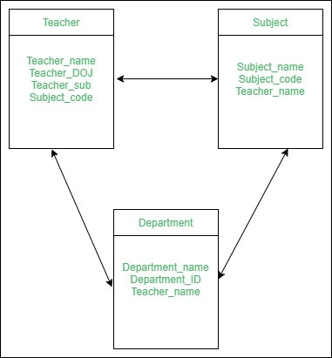
1.6 Schema and Instances
We have a schema that shows the relationship between three tables: Teacher, Subject and Department.
The diagram only shows the design of the database, it doesn’t show the data present in those tables.
Schema is only a structural view(design) of a database as shown in the diagram

Slide 22
1.6 Schema and Instances
Physical Schema:
design of a database at physical level
how the data stored in blocks of storage is described
Logical Schema:
design of database at logical level
programmers and database administrators work at this level
at this level data can be described as certain types of data records gets stored in data structures
View Schema:
design of database at view level
generally describes end user interaction with database systems

Slide 23
1.6 Schema and Instances
Definition of instance:
The data stored in database at a particular moment of time is called instance of database.
Database schema defines the variable declarations in tables that belong to a particular database;
The value of these variables at a moment of time is called the instance of that database.
For example, lets say we have a single table student in the database, today the table has 100 records, so today the instance of the database has 100 records. Lets say we are going to add another 100 records in this table by tomorrow so the instance of database tomorrow will have 200 records in table.
In short, at a particular moment the data stored in database is called the instance, that changes over time when we add or delete data from the database.

Slide 24
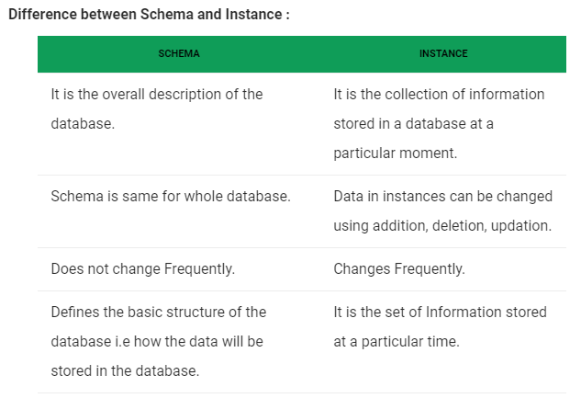
1.6 Schema and Instances

Slide 25
1.7 Concept of DDL, DML and DCL
DDL ( Data Definition Language) : define database structure or schema
DDL commands:
CREATE – is used to create the database or its objects (like table, index, function, views, store procedure and triggers).
DROP – is used to delete objects from the database.
ALTER-is used to alter the structure of the database.
TRUNCATE–is used to remove all records from a table, including all spaces allocated for the records are removed.
COMMENT –is used to add comments to the data dictionary.
RENAME –is used to rename an object existing in the database.
Example:
create table account (account-number char(10), balance integer);

Slide 26
1.7 Concept of DDL, DML and DCL
DML ( Data Manipulation Language) : used to access or manipulate data in database
DML commands:
INSERT – is used to insert data into a table.
SELECT – is used to retrieve data from a table.
UPDATE – is used to update existing data within a table.
DELETE – is used to delete records from a database table.
Example:
select customer.customer-name
from customer
where customer.customer-id = 192;

Slide 27
1.7 Concept of DDL, DML and DCL
There are basically two types:
Procedural DMLs require a user to specify what data are needed and how to get those data.
Declarative DMLs (also referred to as nonprocedural DMLs) require a user to specify what data are needed without specifying how to get those data.
The DML component of the SQL language is nonprocedural.

Slide 28
1.7 Concept of DDL, DML and DCL
DCL ( Data Control Language) : used to control user access to database, table, views, functions etc.
DCL commands:
GRANT-gives user’s access privileges to database.
REVOKE-withdraw user’s access privileges given by using the GRANT command.
TCL(transaction Control Language) : deals with the transaction within the database.
TCL commands:
COMMIT– commits a Transaction.
ROLLBACK– rollbacks a transaction in case of any error occurs.
SAVEPOINT–sets a savepoint within a transaction.

Slide 29
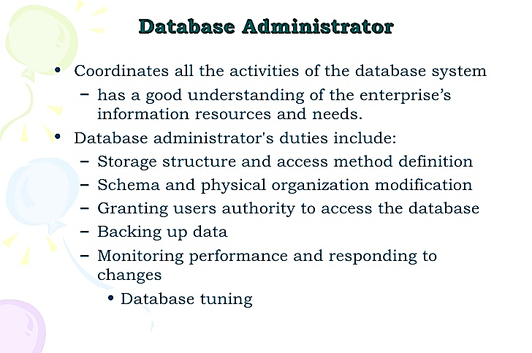
1.8 Database Manager and Users

Slide 30
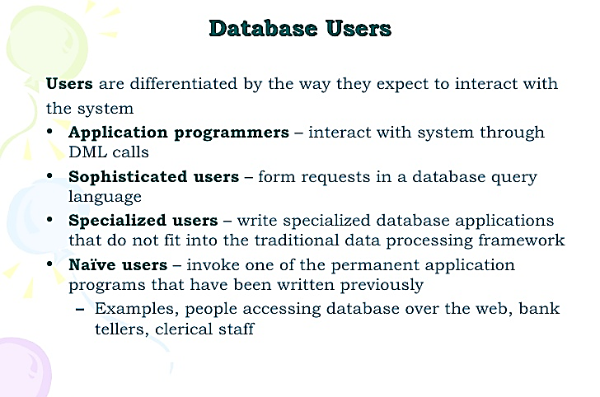
1.8 Database Manager and Users

Slide 31
DBMS Architecture
The DBMS design depends upon its architecture. The basic client/server architecture is used to deal with a large number of PCs, web servers, database servers and other components that are connected with networks.
The client/server architecture consists of many PCs and a workstation which are connected via the network.
DBMS architecture depends upon how users are connected to the database to get their request done.

Slide 32
Types of DBMS Architecture
1-Tier Architecture
In this architecture, the database is directly available to the user. It means the user can directly sit on the DBMS and uses it.
Any changes done here will directly be done on the database itself. It doesn't provide a handy tool for end users.
The 1-Tier architecture is used for development of the local application, where programmers can directly communicate with the database for the quick response.

Slide 33
Types of DBMS Architecture
2-Tier Architecture
The 2-Tier architecture is same as basic client-server. In the two-tier architecture, applications on the client end can directly communicate with the database at the server side. For this interaction, API's like: ODBC, JDBC are used.
The user interfaces and application programs are run on the client-side.
The server side is responsible to provide the functionalities like: query processing and transaction management.
To communicate with the DBMS, client-side application establishes a connection with the server side.

Slide 34
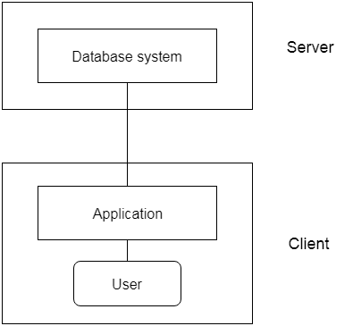
Types of DBMS Architecture
2-Tier Architecture

Slide 35
Types of DBMS Architecture
3-Tier Architecture
The 3-Tier architecture contains another layer between the client and server. In this architecture, client can't directly communicate with the server.
The application on the client-end interacts with an application server which further communicates with the database system.
End user has no idea about the existence of the database beyond the application server. The database also has no idea about any other user beyond the application.
The 3-Tier architecture is used in case of large web application.

Slide 36
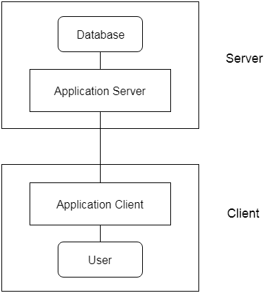
Types of DBMS Architecture
3-Tier Architecture
Presentation layer (your PC, Tablet, Mobile, etc.)
Application layer (server)
Database Server

Slide 37
Types of DBMS Architecture
3-Tier Architecture
Presentation tier
The presentation tier is the user interface and communication layer of the application, where the end user interacts with the application.
Its main purpose is to display information to and collect information from the user. This top-level tier can run on a web browser, as desktop application, or a graphical user interface (GUI), for example.
Web presentation tiers are usually developed using HTML, CSS and JavaScript. Desktop applications can be written in a variety of languages depending on the platform.

Slide 38
Types of DBMS Architecture
3-Tier Architecture
Application tier
The application tier, also known as the logic tier or middle tier, is the heart of the application. In this tier, information collected in the presentation tier is processed - sometimes against other information in the data tier - using business logic, a specific set of business rules.
The application tier can also add, delete or modify data in the data tier.
The application tier is typically developed using Python, Java, Perl, PHP or Ruby, and communicates with the data tier using API calls.

Slide 39
Types of DBMS Architecture
3-Tier Architecture
Data tier
The data tier, sometimes called database tier, data access tier or back-end, is where the information processed by the application is stored and managed.
This can be a relational database management system such as PostgreSQL, MySQL, MariaDB, Oracle, DB2, Informix or Microsoft SQL Server, or in a NoSQL Database server such as Cassandra, CouchDB or MongoDB.
In a three-tier application, all communication goes through the application tier. The presentation tier and the data tier cannot communicate directly with one another.

Slide 40
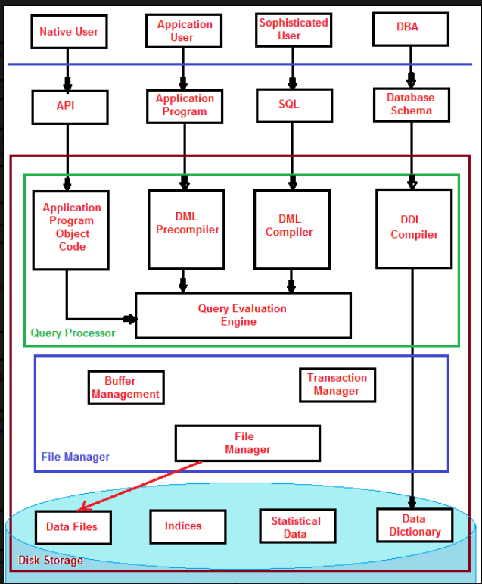
Database System Architecture

Slide 41
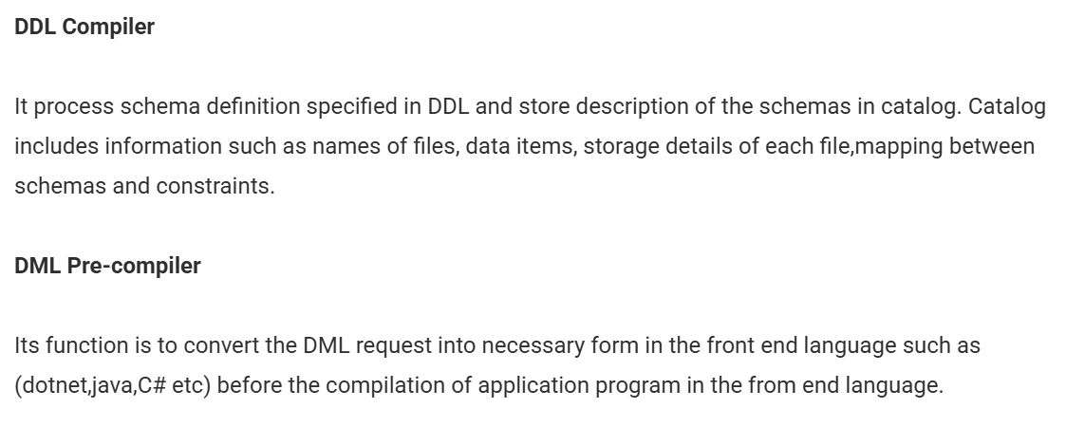
Database System Architecture

Slide 42
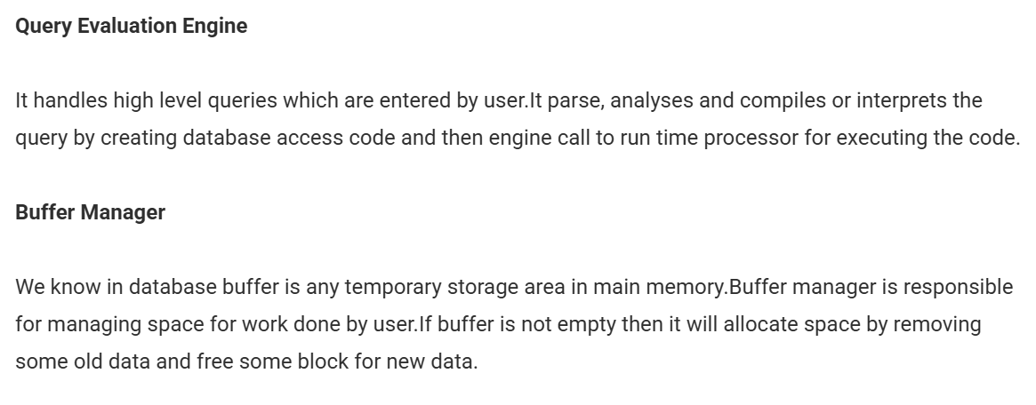
Database System Architecture

Slide 43
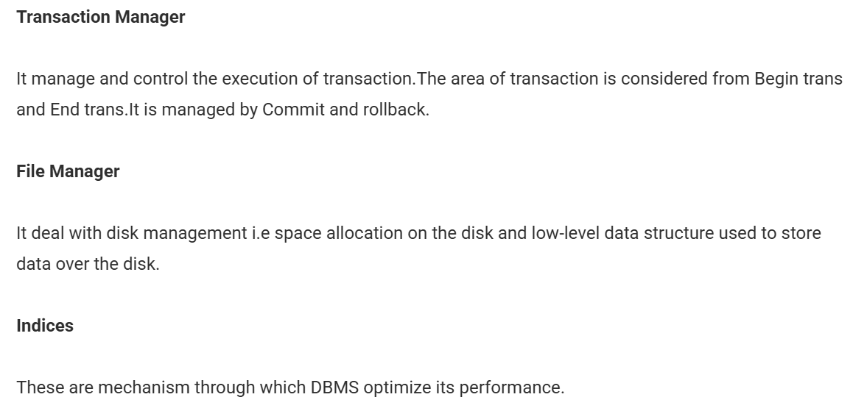
Database System Architecture

Slide 44
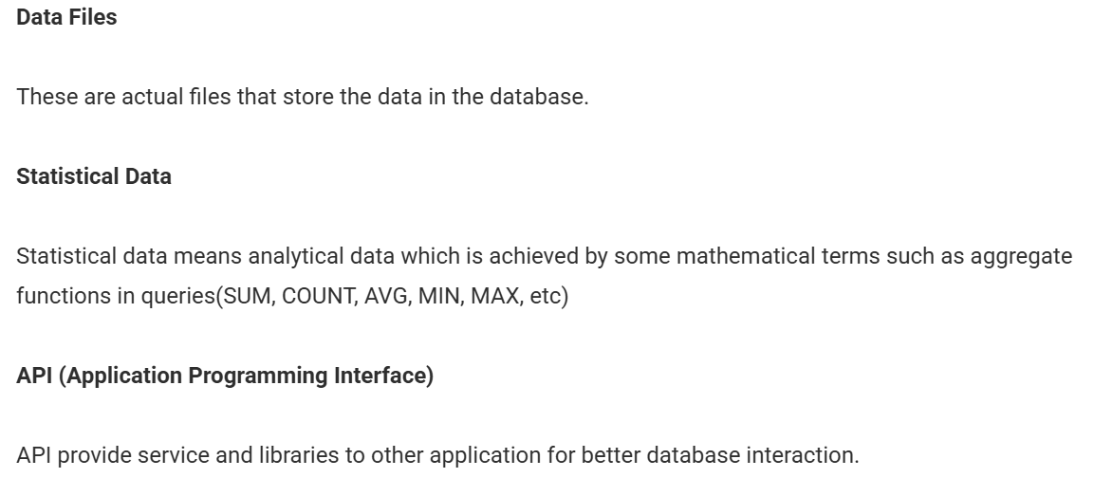
Database System Architecture

Slide 45
Thank You

